Slide 1

Model Deployment using FastAPI
Lili Ayu Wulandhari

Slide 2
Preparation…
Open VSCode terminal
Create the virtual environment as below:
python -m venv venv-name
Open a new terminal within VSCode Ctrl + Shift + P and you'll see that venv is getting picked up; e.g.: (venv) ...
Install library, such as:
pip install pandas
pip install numpy
pip install sklearn
pip install pickle
pip install FastAPI
Prepare the prediction code

Slide 3
Run…
create a FastAPI "instance" and assign it to app
Here the app variable will be an "instance" of the class FastAPI.
This will be the main point of interaction to create all your API.
This app is the same one referred by uvicorn in the command as below:
uvicorn app_name:app --reload, example
uvicorn iris_prediction:app --reload

Slide 4
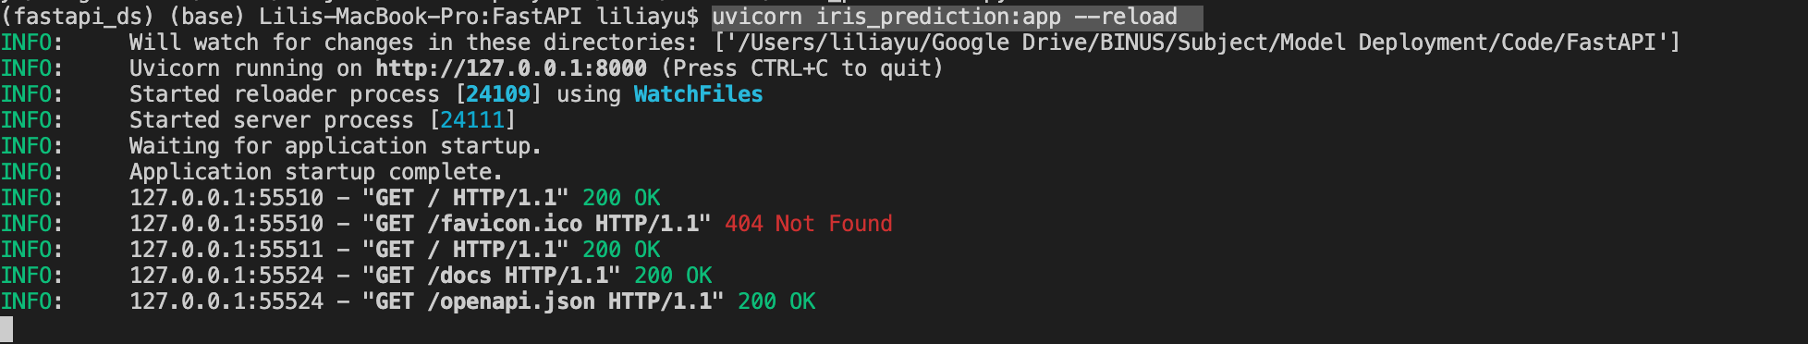
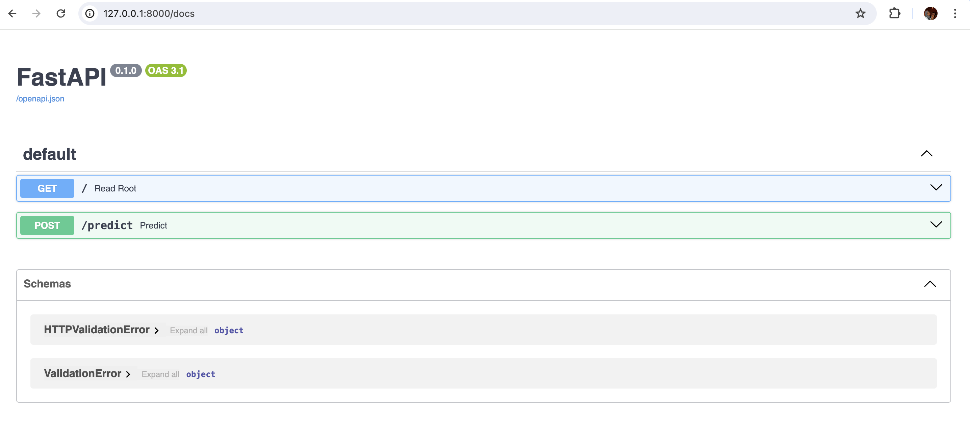
Copy this url http://127.0.0.1:8000/docs in the browser, and get following page to test your apps

Slide 5
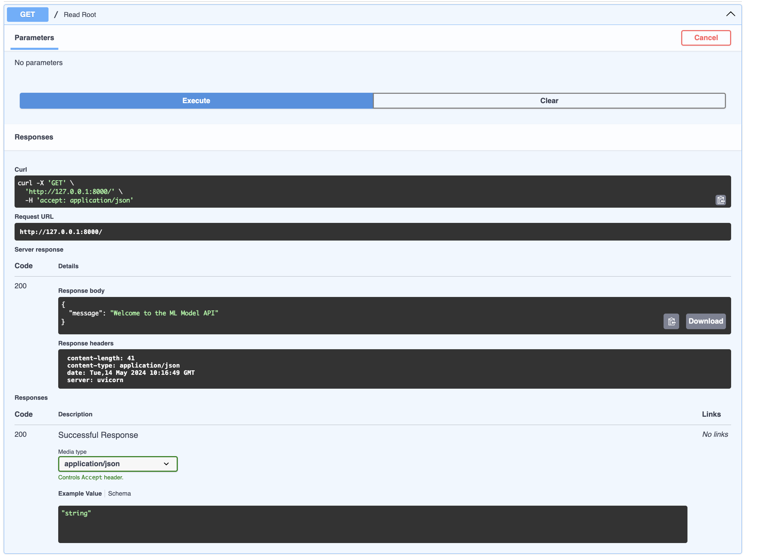
Test your apps..
GET

Slide 6
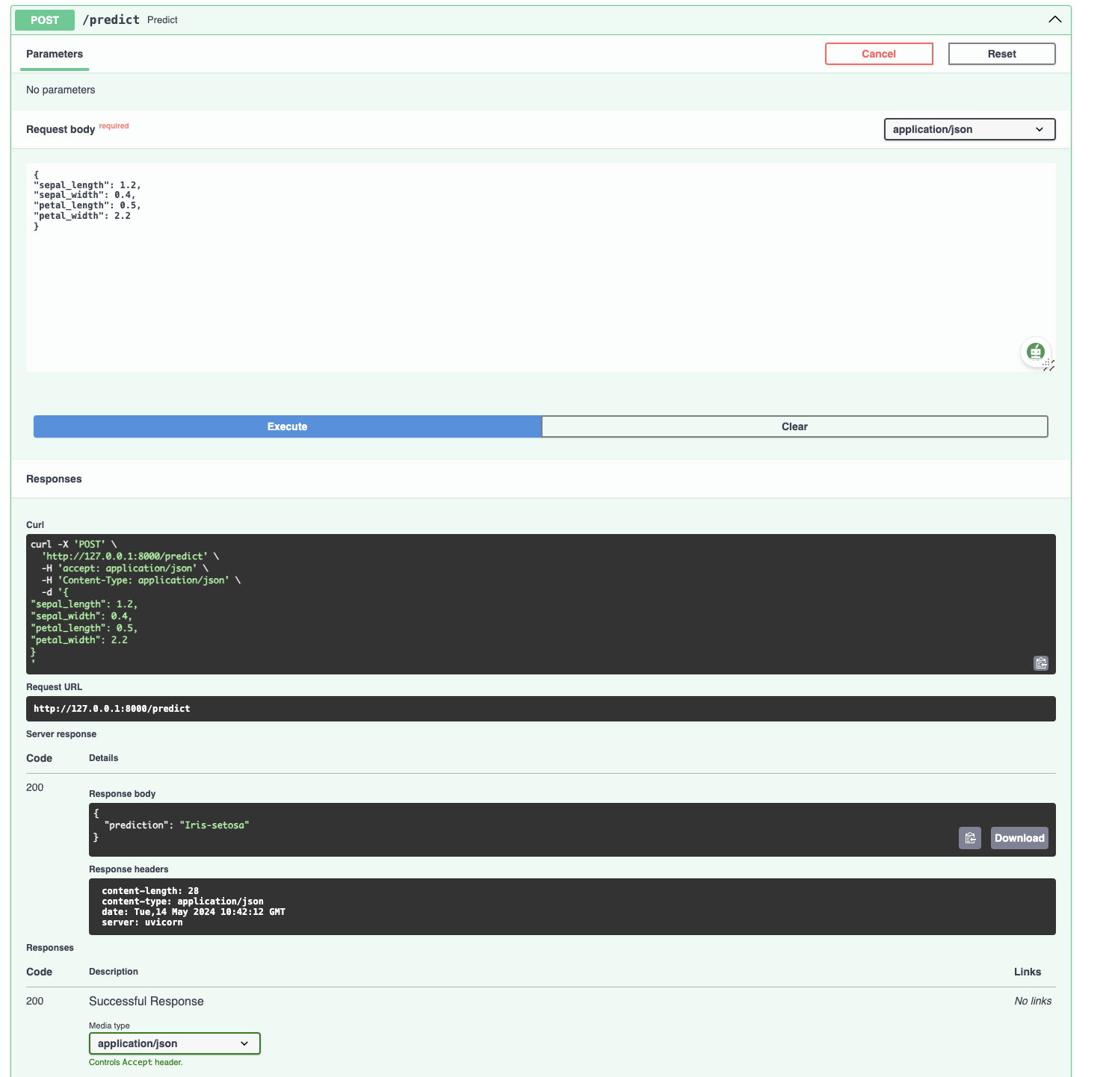
Test your apps..
POST

